Slide 1
Chapter 5
Windows OS And Windows Server Architecture

Slide 2
Windows OS Process Management
Effective Process Management is a vital component of any modern operating system (OS). Applications contain one or more processes, which are used to provide the OS with the resources it needs to execute a program.
Key items associated with application execution in the Windows OS include:
processes, threads, job objects, and thread pools.
Process: A process manages the resources required to execute a program.
Microsoft's Windows OS manages processes using executable units called threads.
Each process is protected from other processes, and contains its own virtual address space, which it shares with all of the threads within the process.

Slide 3
Threads: Within each process, there is one or more threads.
The thread can be scheduled for execution, and manages the communication between different objects.
Threads also have the ability to create new threads within each of its threads, as well as create new processes.
By creating and managing processes, applications can have multiple, concurrent tasks processing files, performing computations, or communicating with other networked systems.
It is even possible to improve application performance by exploiting multiple CPU processors.

Slide 4
Each Windows process includes resources such as the following components:
One or more threads.
A virtual address space that is distinct from other processes’ address spaces. Note that shared memory-mapped files share physical memory, but the sharing processes will probably use different -virtual addresses to access the mapped file.
One or more code segments, including code in DLLs.
One or more data segments containing global variables.
Environment strings with environment variable information, such as the -current search path.
The process heap.
Resources such as open handles and other heaps.

Slide 5
Each thread in a process shares code, global variables, environment strings, and resources. Each thread is independently scheduled, and a thread has the following elements:
A stack for procedure calls, interrupts, exception handlers, and automatic storage.
Thread Local Storage (TLS)-An arraylike collection of pointers giving each thread the ability to allocate storage to create its own unique data environment.
An argument on the stack, from the creating thread, which is usually unique for each thread.
A context structure, maintained by the kernel, with machine register values.

Slide 6
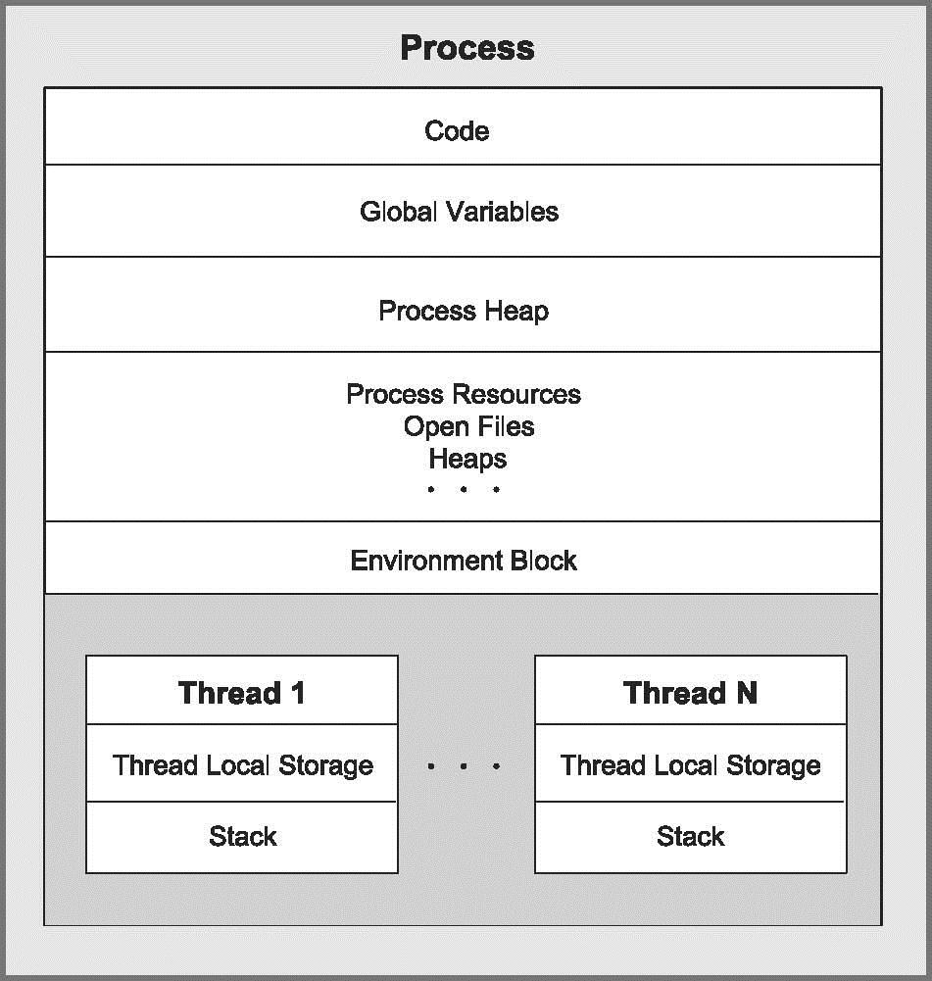
Figure shows a process with several threads.
This figure is schematic and does not indicate actual memory addresses.

Slide 7
Control Panel
The Control Panel is a feature of the Windows operating system that allows the user to modify system settings and controls.
It includes several small applications, or control panels, that can be used to view and change hardware or software settings.
Some examples of hardware control panels are Display, Keyboard, and Mouse settings.
Software control panels include Date and Time, Power Options, Fonts, and Administrative Tools.
Many control panels are included as part of the Windows operating system, but others can be installed by third-party applications or utilities.
For example, if you add a new mouse to your computer, it may come with a CD for installing a control panel specific for that mouse.
The Windows Control Panel can be accessed by clicking the Start menu and selecting Control Panel.

Slide 8
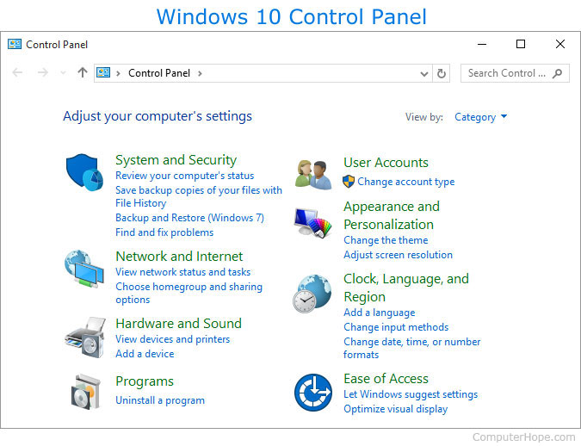

Slide 9
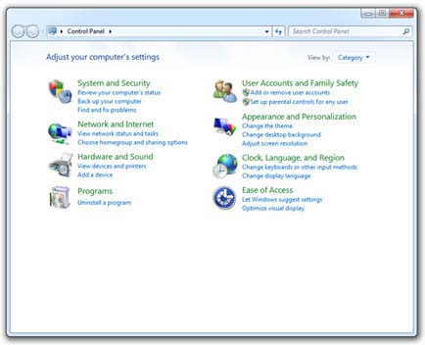
Windows 7 Control panel

Slide 10
User Accounts in Windows
Windows offers three types of user accounts:
Administrator,
Standard,
Guest. (It also offers a special Standard account for children.)
Here’s how the different accounts translate into computer lingo:
Administrator: The administrator controls the entire computer, deciding who gets to play with it and what each user may do on it.
On a computer running Windows, the owner usually holds the almighty Administrator account. He or she then sets up accounts for each household member and decides what they can and can’t do with the PC.

Slide 11
Standard: Standard account holders can access most of the computer, but they can’t make any big changes to it.
They can’t run or install new programs, for example, but they can run existing programs.
Child: The Child account setting is actually just a Standard account with the Family Safety settings automatically turned on.
Guest: Guests can play with the computer, but the computer doesn’t recognize them by name.
Guest accounts function much like Standard accounts but with no privacy: Anybody can sign in with the Guest account, and the desktop will look the way the last guest left it.

Slide 12
Windows 10 offers a spectrum of security settings to help keep your computer safe.
However, navigating so many security options can be complex and confusing for the average business owner
To help you with your Windows 10 security settings, here are five important security risks to consider and how to fix them.
From there you'll also find other security options to help keep your computer safe.
1. Privacy
One security risk with Windows 10 is the sharing of private data, particularly for the use of personal services.
For instance, Windows 10 automatically assigns an advertising ID to each user to provide tailored ads while they surf the web and use supported apps.
Microsoft also collects and syncs users' data with its servers, which is especially problematic for business users.

Slide 13
To protect your privacy, Windows 10 lets you disable specific types of data sharing. Here's how:
Go to Settings.
Click on Privacy.
Click on the General tab.
From here you can toggle different privacy settings, such as disable advertising ID and location tracking.
You can also restrict access to your camera and microphone, as well as control which apps have access to your contacts, calendar and messages.
You can set how much data Microsoft collects about your speech, typing and other computer usage to personalize

Slide 14
2. Windows updates
Like previous versions of Windows, Windows 10 sends out regular software updates, fixes and security patches, and then automatically installs them. The problem arises when updates interfere with your work or slow down performance, and when there are security risks to installing them.
Here's how to access your Windows updates settings:
Click on the Start button.
Go to Settings.
Choose Update & Security.
Select Windows Update on the left.
Click on Advanced options.
From here you can choose to have Windows automatically install updates when you are not using your computer, as well as make sure your updates are coming directly from Microsoft and not third-party networks or services.

Slide 15
3. Wi-Fi settings
Securing your Wi-Fi settings is one of the best ways to protect yourself from cyberattacks.
Windows 10 makes finding and connecting to hotspots easier, but doing so comes with significant security risks.
Hackers can easily access your private data over public networks, so your best bet is to turn off connections to open hotspots.
You can do this by going to Settings, clicking on Network & Internet, and then choosing Manage Wi-Fi Settings.
Windows 10 also lets you share your Wi-Fi connections with friends using certain apps, such as Facebook and Outlook.
It is generally a security risk if it is always turned on. You can disable Wi-Fi sharing in the Network & Internet settings page.

Slide 16
4. Backups
Windows 10 can automatically create backups to restore your system in the event of a crash or cyberattack.
However, these backups are not secure and can be accessed by anyone who hacks into your computer.
As an alternative, you can create your own full-system image on external storage, such as a USB, DVD or external drive.
Here's how:
Open Control Panel.
Go to File History.
Click on System Image Backup.
Choose where to save your backup.
Click on Start Backup.

Slide 17
Identify Accessibility Settings
Accessibility options are built into Windows to help users who may have trouble using their computers normally get a little more functionality out of their favorite OS.
Even so, here’s how to manage all the accessibility options available in the latest update of Windows 10.
Narrator
For the blind or those with acute sight limitations, Narrator is a vital tool which will read off the contents of any page, window, or application your click into piece by piece, while also reciting the specific portions of those selections out loud.

Slide 18
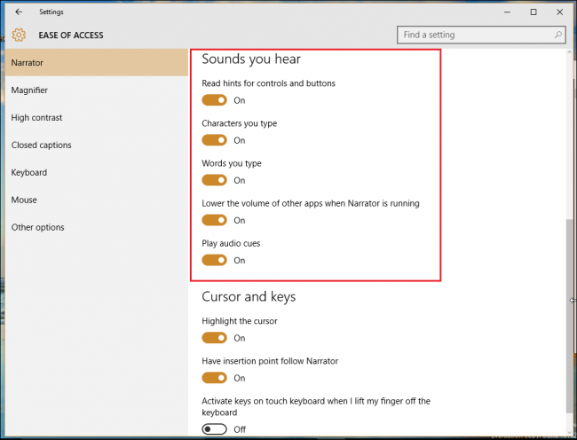

Slide 19
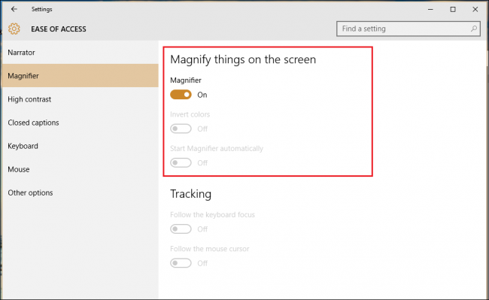
Magnifier
Magnifier is yet another of the Windows Ease of Access features designed to assist anyone who either has trouble reading their screen, or even just creative professionals wants a tool that will allow them to get a close up view of detail work in 3D modeling, Photoshop, or game design.

Slide 20
High Contrast
Sticking with the concept of “making things easier”, Microsoft has opted to group all its visual accessibility features into the top three choices in the Ease of Access panel.
Keyboard
The keyboard options in Ease of Access has always been one of Windows shining points, offering up a wide range of customization that will help anyone with disabilities or special needs have exactly the PC experience they want every time they boot up and log in.
Mouse
Options to change the mouse around are pretty slim, but if you have problems seeing the cursor and need to enlarge it for enhanced viewability, this is the place to do it.

Slide 21
Other Options
Last but not least, Ease of Access has a few odds and ends that can hone down the Windows 10 experience to fit your browsing style as best as possible. Here you can change things like whether or not Windows uses animations throughout the experience, whether the desktop displays a background, or how long a notification will pop up from the toolbar before flashing away.

